Slide 1


How to live in the Data-Science bubble?
Balaji Sundaresan - NJ Data Science Meet-up, 08/27/2016
Notes:
So what was the idea that came out of that initial exploration?
Let us take a look!
The idea was to develop a tool that would represent and persist knowledge structures comprised of knowledge states in a graphical datastore. This should also show the hierarchical structure of how the knowledge states are related, preferably by using the labeled edges of the graphs. The repository should be able to
depict the Bayesian Knowledge Tracing probability weights depicted by labels added
to edges.
The tool would also persist the mapping of the learning maps with knowledge states. It should also persist the
mapping of assessment questions with knowledge states.

Slide 2

Why: A Guide to Finding and Using Causes by Samantha Kleinberg
Books !!
Balaji Sundaresan - NJ Data Science Meet-up, 08/27/2016
Notes:
So what was the idea that came out of that initial exploration?
Let us take a look!
The idea was to develop a tool that would represent and persist knowledge structures comprised of knowledge states in a graphical datastore. This should also show the hierarchical structure of how the knowledge states are related, preferably by using the labeled edges of the graphs. The repository should be able to
depict the Bayesian Knowledge Tracing probability weights depicted by labels added
to edges.
The tool would also persist the mapping of the learning maps with knowledge states. It should also persist the
mapping of assessment questions with knowledge states.

Slide 3
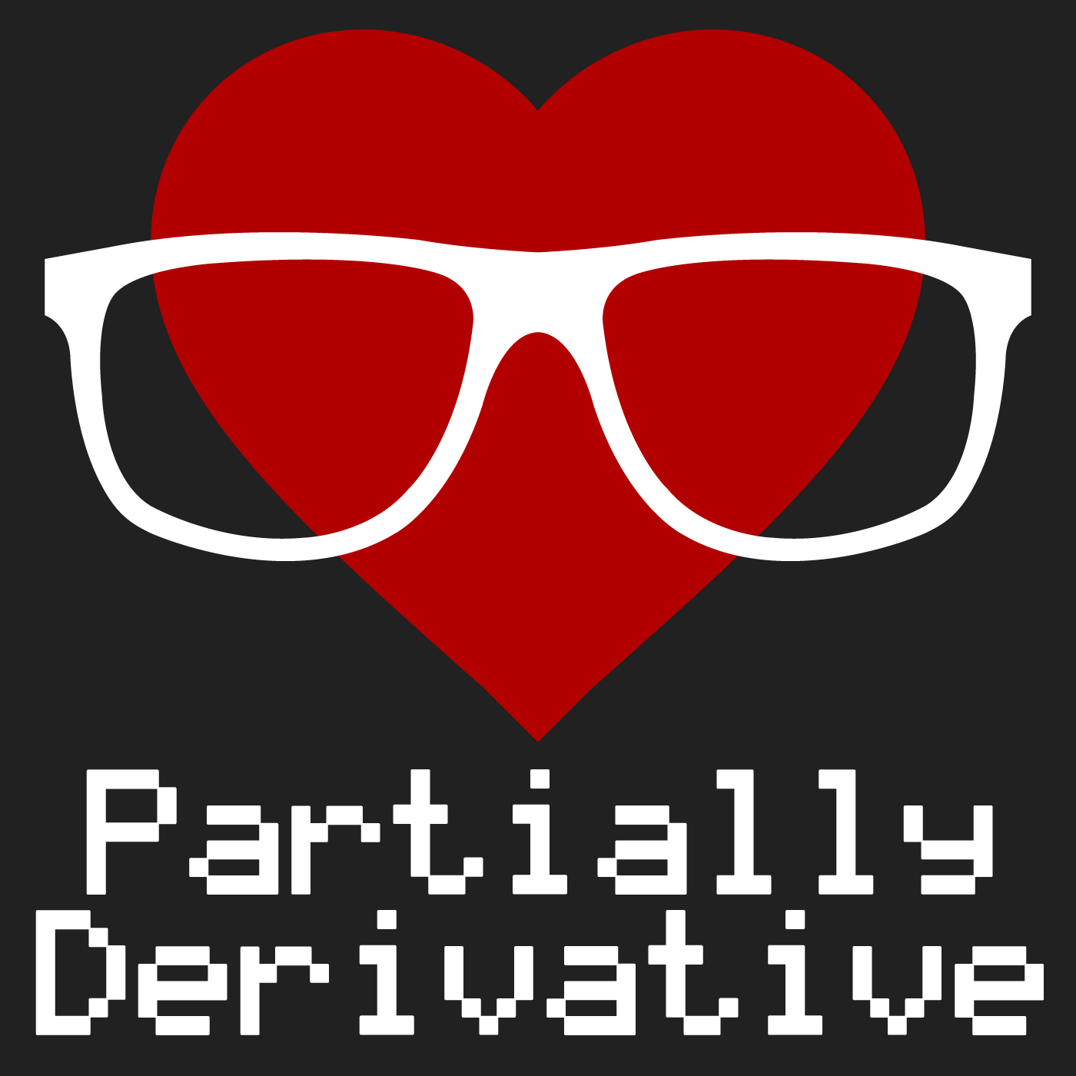
Podcast !!
Partially Derivative hosted by Jonathon Morgan, Chris Albon & Vidya Spandana
Balaji Sundaresan - NJ Data Science Meet-up, 08/27/2016
Notes:
Let us go through the high level design. The system is comprised of two main subsystems:
The Graphical Persistent Store is a graphical datastore that represents and persists knowledge structures comprised of knowledge states and associated concepts.
The Knowledge Space Framework (KSF) (comprised of the Restful API) is a reusable knowledge space management framework that can be leveraged by ALSs using standardized APIs. It has a standardized Restful API which allows creation, navigation and querying of the knowledge structures.
A web-based Intelligent Tutoring System prototype was also developed to showcase how the KSF APIs can be integrated with an external ALS. It is entirely developed as a client side (browser based) web application.

Slide 4
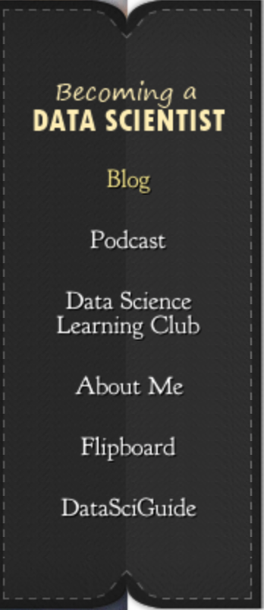
Documenting my path from "SQL Data Analyst pursuing an Engineering Master's Degree" to "Data Scientist
Becoming A Data Scientist by Renee M. P. Teate
Blogs!!
Balaji Sundaresan - NJ Data Science Meet-up, 08/27/2016
Notes:
So what was the idea that came out of that initial exploration?
Let us take a look!
The idea was to develop a tool that would represent and persist knowledge structures comprised of knowledge states in a graphical datastore. This should also show the hierarchical structure of how the knowledge states are related, preferably by using the labeled edges of the graphs. The repository should be able to
depict the Bayesian Knowledge Tracing probability weights depicted by labels added
to edges.
The tool would also persist the mapping of the learning maps with knowledge states. It should also persist the
mapping of assessment questions with knowledge states.

Slide 5
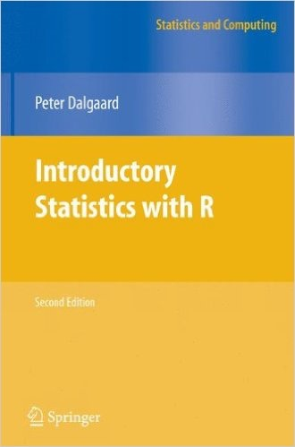
Tools !!
After closing about 200,000 option transactions (that is separate option tickets) over 12 years and studying about 70,000 risk management reports, I felt that I needed to sit down and reflect on the thousands of mishedges I had committed.
I clambered up to my attic where, during 6 entire months, I spent 14 hours a day, 7 days a week, immersed in probability theory, numerical analysis, and mathematical statistics (at a Ph.D. level).
- Nassim Taleb, Dynamic Hedging: Managing Vanilla and Exotic Options
Balaji Sundaresan - NJ Data Science Meet-up, 08/27/2016
Notes:
Here is a screenshot taken from the skeleton ITS prototype that consumes the KSF framework. The screenshot here shows the full page view of the main screen.

Slide 6

To be human is to be 'a' human, a specific person with a life history and idiosyncrasy and point of view; artificial intelligence suggest that the line between intelligent machines and people blurs most when a puree is made of that identity.
- Brian Christian, The Most Human Human: What Talking with Computers Teaches Us About What It Means to Be Alive
What’s Next ?
Balaji Sundaresan - NJ Data Science Meet-up, 08/27/2016
Notes:
So what is the future of this framework. What can be developed further on top of this?

